Slide 1
Artificial Intelligence
Lecture 03

Slide 2
Goals of AI
To Create Expert Systems: The systems which exhibit intelligent behavior, learn,demonstrate, explain, and advice its users.
To Implement Human Intelligence in Machines: Creating systems that understand, think, learn, and behave like humans.

Slide 3
AI is about
Thinking
Perception
Action

Slide 4
Types of artificial intelligence
AI can be categorized into two levels based on its capabilities:
Weak AI
Weak AI is AI that can not 'think', i.e. a computer chess playing AI does not think about its next move, it is based on the programming it was given, and its moves depend on the moves of the human opponent. (dedicated tasks with intellegence)
Computers can be programmed to act as if they were intelligent (as if they were thinking)
Apple Siri
Flying machine
Strong AI
Strong AI is the idea/concept that we will one day create AI that can 'think' i.e. be able to play a chess game that is not based on the moves of the human opponent or programming, but based on the AI's own 'thoughts' and feelings and such, which are all supposed to be exactly like a real humans thoughts and emotions and stuff.
Computers can be programmed to think (i.e. they really are thinking)
Self driving cars

Slide 5
AI Questions
Can we make something that is as intelligent as a human?
Can we make something that is as intelligent as a bee?
Can we make something that is self improving, autonomous, and flexible?
Can we save this plant $20M/year by pattern recognition?
Can we save this bank $50M/year by automatic fraud detection?
Can we start a new industry of handwriting recognition agents?

Slide 6
Which of these exhibits intelligence?
You beat somebody at chess.
You prove a mathematical theorem using a set of known axioms.
You need to buy some supplies, meet three different colleagues, return books to the library, and exercise. You plan your day in such a way that everything is achieved in an efficient manner.
You are a lawyer who is asked to defend someone. You recall three similar cases in which the defendant was guilty, and you turn down the potential client.
A stranger passing you on the street notices your watch and asks, “Can you tell me the time?” You say, “It is 3:00.”

Slide 7
Which of these exhibits intelligence?
You are a six-month-old infant. You can produce sounds with your vocal organs, and you can hear speech sounds around you, but you do not know how to make the sounds you are hearing. In the next year, you figure out what the sounds of your parents' language are and how to make them.

Slide 8
Which of these can currently be done?
Play a decent game of table tennis
Drive autonomously along a curving mountain road
Drive autonomously in the center of Tokyo
Play a decent game of bridge
Discover and prove a new mathematical theorem
Write an intentionally funny story
Give competent legal advice in a specialized area of law
Translate spoken English into spoken Swedish in real time
Plan schedule of operations for a NASA spacecraft
Defeat the world champion in chess

Slide 9
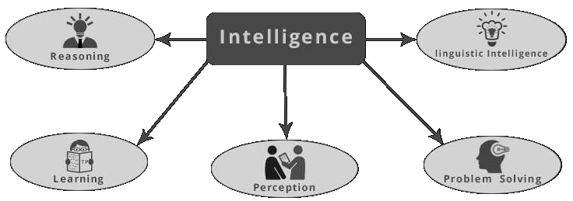

Slide 10
Reasoning: basis for judgement, making decisions, and prediction.
Learning: It is the activity of gaining knowledge or skill by studying, practising, being taught, or experiencing something.
Problem solving: the process of identifying and fixing issues, or achieving goals by overcoming obstacle.

Slide 11
Perception: process of acquiring, interpreting, selecting, and organizing sensory information.
Linguistic Intelligence: ability to comprehend, speak, and write the verbal and written language.

Slide 12
What differentiate from machines to humans? and humans to animals?

Slide 13
Human Intelligence VS Artificial Intelligence
The important aspects of human intelligence seem to following the use of common sense, judgment, creativity, goal directedness, reasoning, knowledge and beliefs.
Meaning of intelligence is not human brain’s information processing ability but the ability of humans to demonstrate their intelligence by communicating effectively.

Slide 14
Human Intelligence
Artificial Intelligence
Common sense, Judgement, Creativity, Beliefs etc
The ability to demonstrate their intelligence by communicating effectively
Reasoning and Critical thinking
Ability to simulate human behavior and cognitive processes
Capture and preserve human expertise
Fast Response. The ability to comprehend large amounts of data quickly.

Slide 15
Human Intelligence
Artificial Intelligence
Humans are fallible
They have limited knowledge bases
Information processing of serial nature proceed very slowly in the brain as compared to computers
Humans are unable to retain large amounts of data in memory.
No “common sense”
Cannot deal with “mixed” knowledge
May have high development costs
Raise legal and ethical concerns

Slide 16
Knowledge Based Systems
A knowledge-based system (KBS) is a computer program that reasons and uses a knowledge base to solve problems.
The term "knowledge-based system" was often used interchangeably with "expert system", possibly because almost all of the earliest knowledge-based systems were designed for expert tasks. However, these terms tell us about different aspects of a system:
expert: describes only the task the system is designed for – its purpose is to aid replace a human expert in a task typically requiring specialised knowledge
knowledge-based: refers only to the system's architecture – it represents knowledge explicitly, rather than as code.
KBSes can assist in decision-making, human learning.

